Slide 1



Department of Computer Science and Engineering
Analyzing Speech Emotions using LSTM-Decision Trees
V Karthick
Associate Professor
Department of Computer Science and Engineering
Presented by
Thrisha M(210701292) Vamsee Raj MR(210701300)

Slide 2
ABSTRACT
This project advances Speech Emotion Recognition (SER) using Python, focusing on LSTM and deep learning algorithms to analyze emotions in speech. Training a sophisticated model with Decision Tree techniques on a labeled audio dataset, it achieves high accuracy in emotion classification. The study emphasizes the model's interpretability and transparency, enhancing human-computer interaction by recognizing and resonating with conveyed emotions. This work promises improved human-machine communication and personalized experiences by predicting human needs based on emotional cues.
Keywords - Speech Emotion Recognition (SER), Deep Learning, LSTM, Python, Emotion Classification, Audio Analysis, Human-computer Interactions, Decision Tree, K Nearest Neighbours, Logistic Regression, Support Vector, Waveform Analysis, Spectrogram Analysis.
﻿

Slide 3
INTRODUCTION
Introducing the Speech Emotion Recognition Project in AI, a cutting-edge initiative at the intersection of technology and emotional intelligence. This project endeavors to develop a sophisticated system that can accurately detect and interpret human emotions embedded in spoken language. Utilizing advanced machine learning algorithms and deep neural networks, our goal is to create a real-time emotion recognition solution capable of understanding the nuanced dynamics of communication. With applications ranging from customer service to mental health monitoring, this project represents a transformative leap in harnessing AI to decode and respond to the emotional nuances of Speech.

Slide 4
LITERATURE SURVEY
SNO | TITLE | AUTHOR | JOURNAL | YEAR PUBLISHED | CONTRIBUTION
1 | IEMOCAP: Interactive Emotional Dyadic Motion Capture Database | Carlos Busso Zhigang Deng Serdar Yildirim, | Language Resources and Evaluation Journal | 2008 | Provided a rich dataset for emotion research, capturing spontaneous and naturalistic emotional expressions in dyadic interactions.
2 | AVEC 2011 - The First International Audio/Visual Emotion Challenge | Björn Schuller Maja Pantic Roddy Cowie Toni Bresin | The Journal of Deaf Studies and Deaf Education, Volume 11, Issue 1, Winter 2006, | 2022 | Introduced the AVEC series, a benchmark for multimodal emotion recognition, fostering research in audio-visual emotion analysis.

Slide 5
s.no | TITLE | AUTHOR | JOURNAL | YEAR PUBLISHED | CONTRIBUTION
3 | Emotion Recognition from Arbitrary Chinese Speech Based on Segmental Feature and Ensemble Learning | Wenming Zheng Yang Gao Zhongzhe Xiao Bing Zhang | IEEE Transactions on Affective Computing | 2015 | Proposed a method using segmental features and ensemble learning for improved emotion recognition in Chinese speech.
4 | Source and expression in laughter | Ellen Douglas-Cowie Roddy Cowie Iain Sneddon | Annals of the New York Academy of Sciences | 2003 | Explored the sources and expressions of laughter, contributing to the understanding of laughter in the context of emotion
5 | The Interspeech 2010 Paralinguistic Challenge | Stefan Steidl Anton Batliner Björn Schuller | Speech Communication | 2011 | fostering research on automatic analysis of non-verbal vocal expressions.

Slide 6
SNO | TITLE | AUTHOR | JOURNAL | YEAR PUBLISHED | CONTRIBUTION
6 | Learning Discriminative and Shared Feature Representation for Deep Network With Applications to Face Recognition | Zixing Zhang Yu Zhang Hengheng Zhang | IEEE Transactions on Image Processing | 2018 | Introduced a method for learning discriminative and shared feature representations, contributing to the improvement of face recognition, a technique applicable to emotion recognition.
7 | Emotion Recognition from Speech Signals using New Harmony Features | Mohamed S. Kamel Sherif S. Abdelazeem | Neural Networks | 2017 | Proposed new harmony features for emotion recognition from speech signals, demonstrating improved performance compared to traditional methods.
8 | End-to-End Multi-Modal Emotion Recognition using Deep Neural Networks | Shichao Zhang Shiqing Zhang Fanglin Chen Qiang Ji | IEEE Transactions on Affective Computing | 2019 | Presented an end-to-end multi-modal emotion recognition system utilizing deep neural networks, integrating information from multiple modalities.

Slide 7
SNO | TITLE | AUTHOR | JOURNAL | YEAR PUBLISHED | CONTRIBUTION
9 | Emotion Recognition from Arbitrary Chinese Speech Based on Segmental Feature and Ensemble Learning. | Wenming Zheng Yang Gao Zhongzhe Xiao Bing Zhang | IEEE Transactions on Affective Computing | 2015 | Proposed a method using segmental features and ensemble learning for improved emotion recognition in Chinese speech.
10 | Speech emotion recognition | Ashish B Ingale DS Chaudhari | International Journal of Soft Computing and Engineering (IJSCE) | 2012 | This paper is a survey of speech emotion classification addressing three important aspects of the design of a speech emotion recognition system.

Slide 8
RESEARCH GAP
1.Dataset Diversity and Size:
Existing datasets often lack diversity in demographics and language variations.
2.Real-Time Processing:
Many models are not optimized for real-time emotion recognition, leading to latency issues.
3.Model Interpretability:
Deep learning models lack transparency, making it difficult to understand decision-making processes.

Slide 9
RESEARCH GAP
4.Cross-Domain Adaptability:
Models often do not generalize well to different environments or domains.
5.Emotional Context Awareness:
Most systems do not account for the context in which emotions are expressed.
6.Evaluation Metrics:
Standard metrics may not fully capture the performance and usability of SER systems in real-world applications.
7.Emotion Complexity:
Current models fail to capture complex and mixed emotional states.

Slide 10
PROPOSED METHODOLOGY
1. Data Handling:
- Collect diverse audio dataset.
- Preprocess for feature extraction.
2. Model Development:
- Choose deep learning model (e.g., LSTM, RNN).
- Train for real-time emotion classification.
3.Real-Time Processing:
- To develop a system that can recognize and classify emotions in real-time from audio input.
4.Training:
-Split the dataset into training, validation, and test sets.
-Train the model using appropriate loss functions and optimizers.

Slide 11
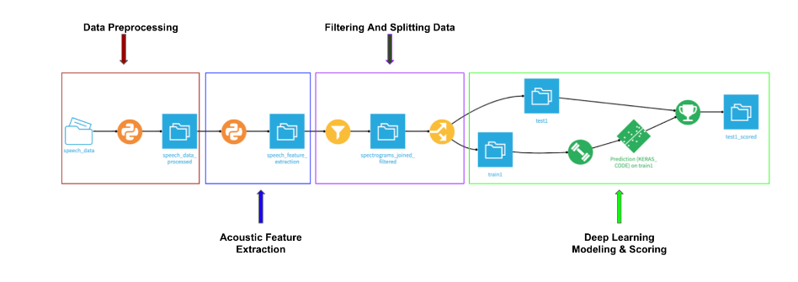
PROPOSED METHODOLOGY

Slide 12

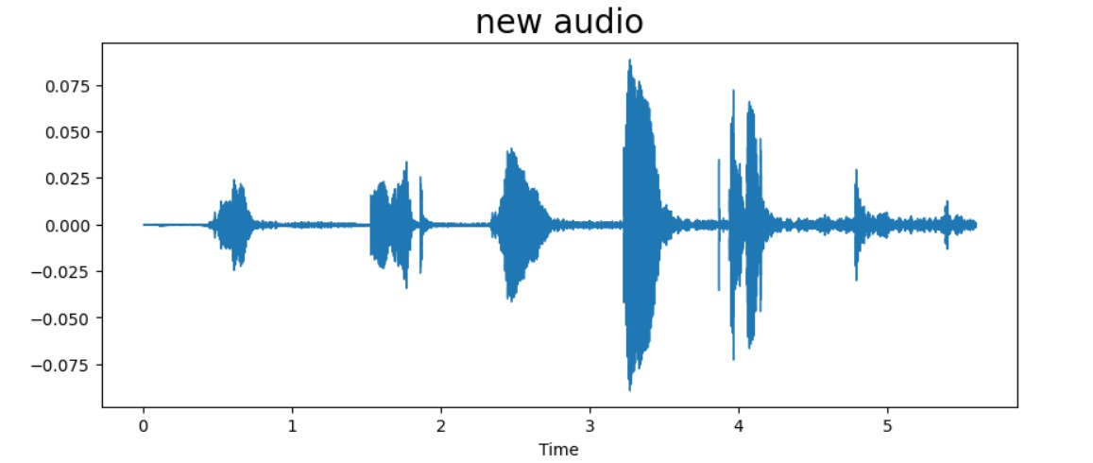
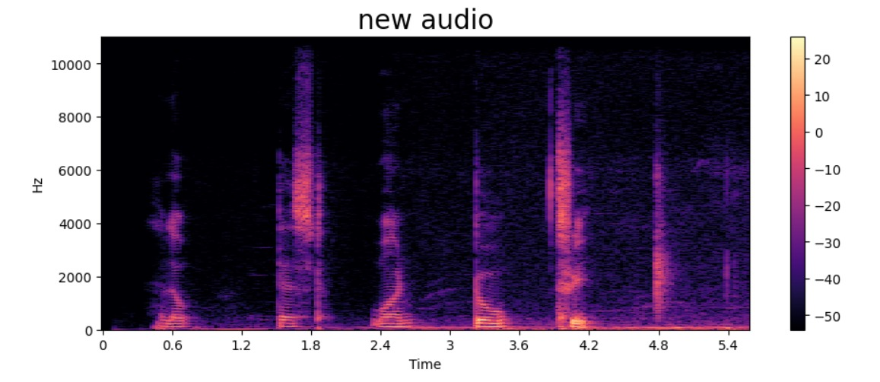
RESULT AND DISCUSSION

Slide 13

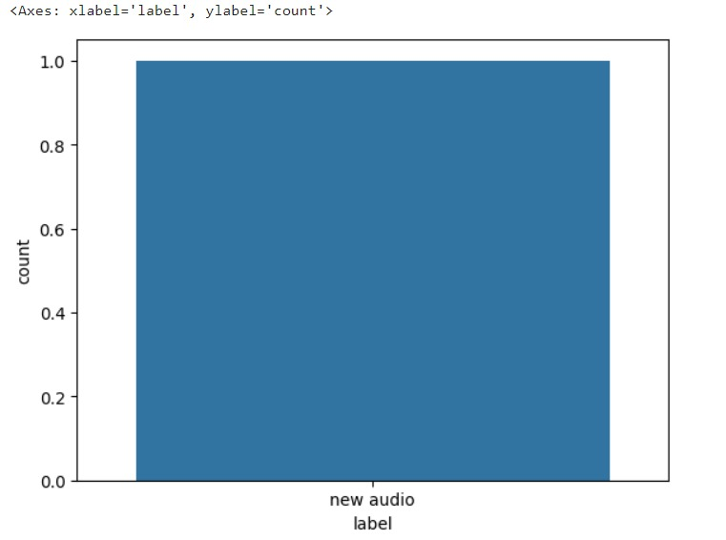
RESULT AND DISCUSSION

Slide 14
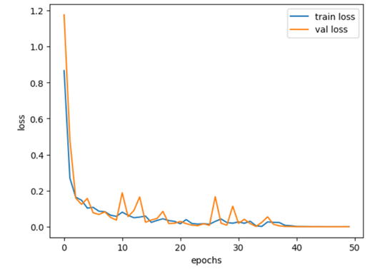
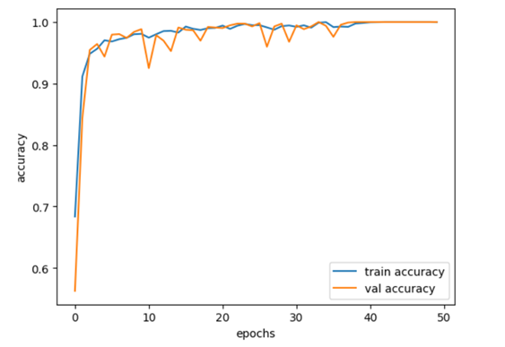
RESULT AND DISCUSSION

Slide 15
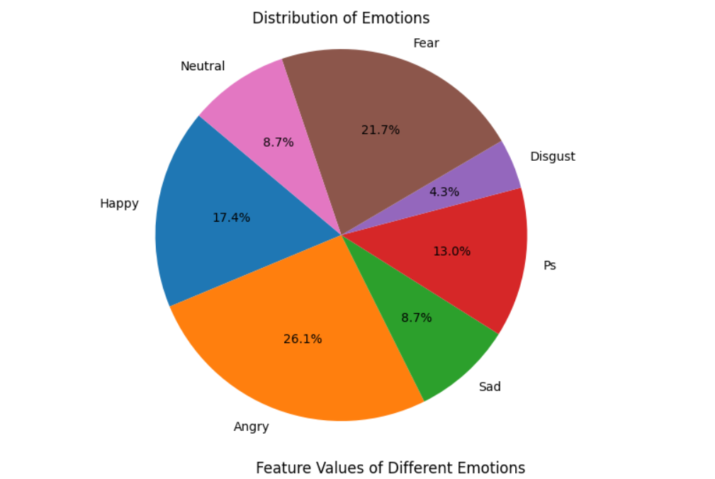
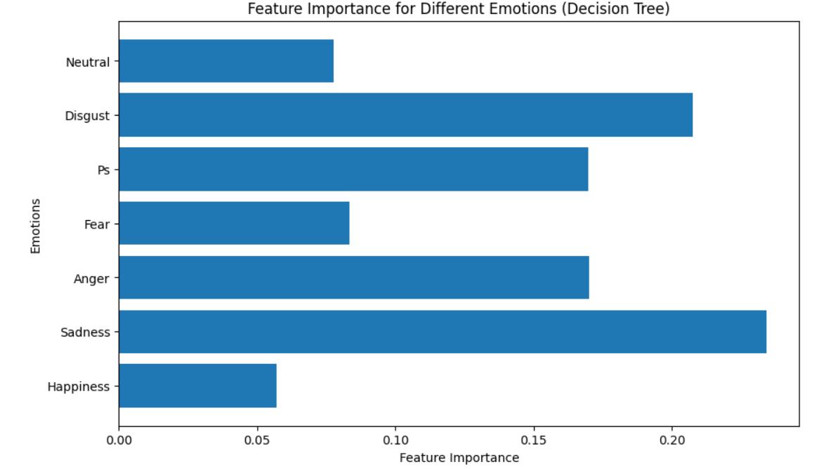
COMPARITIVE ANALYSIS

Slide 16
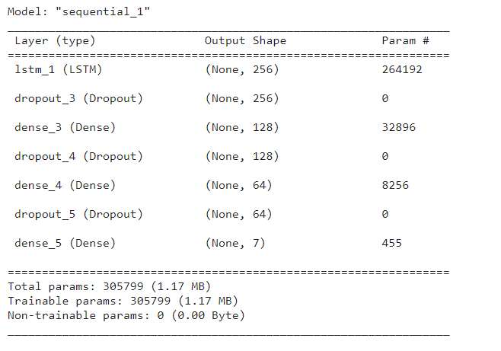
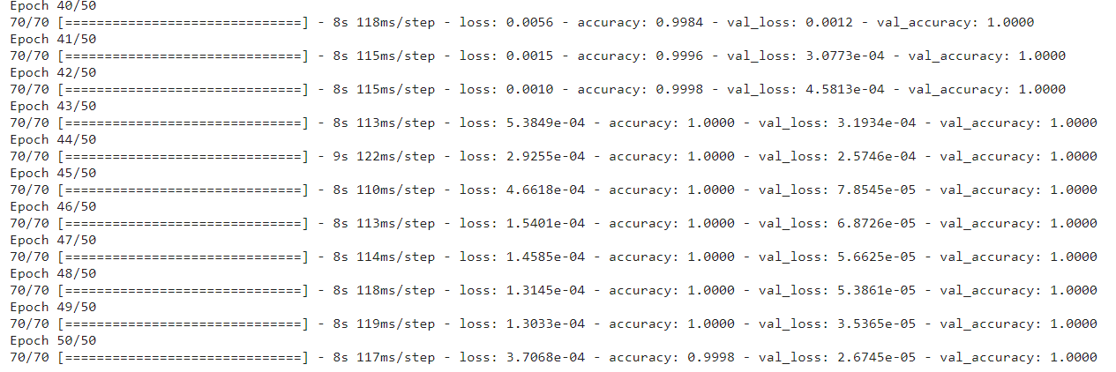
COMPARITIVE ANALYSIS

Slide 17
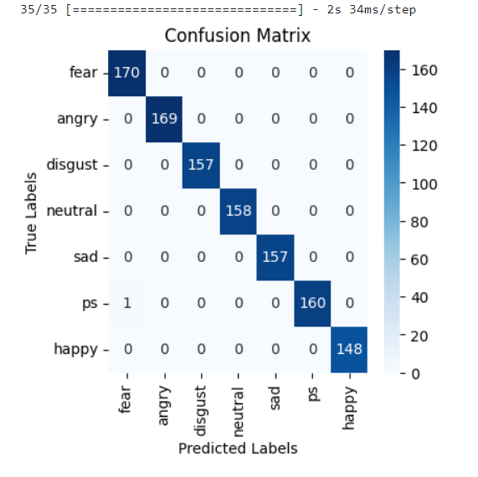
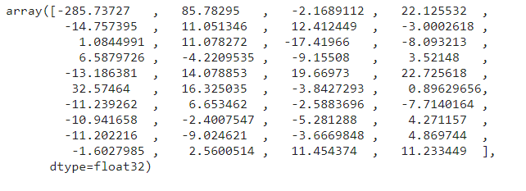
COMPARITIVE ANALYSIS

Slide 18
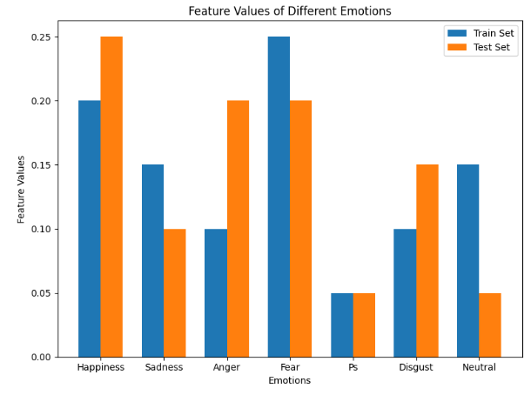
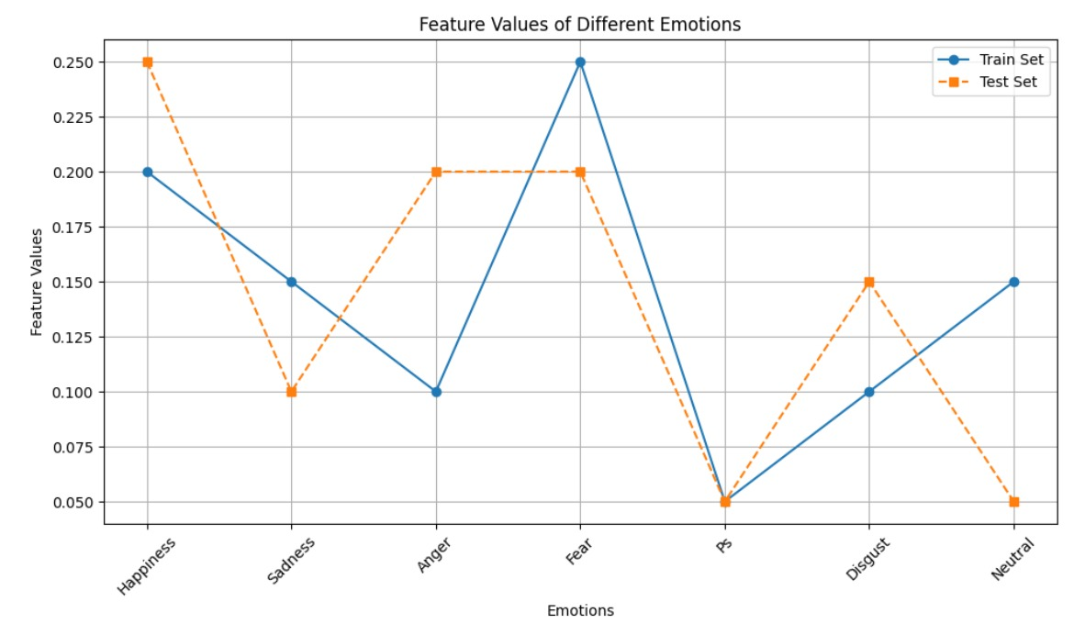
COMPARITIVE ANALYSIS

Slide 19
CONCLUSION & FUTURE WORK
The application of deep learning in speech emotion recognition has demonstrated remarkable success, achieving an impressive overall accuracy of 98.75%. This substantial accuracy underscores the efficacy of deep learning models in capturing nuanced patterns within audio data to discern emotional states. As we look to the future, continued advancements in model architectures, multimodal integration, and personalized emotion models hold the promise of further elevating the precision and applicability of speech emotion recognition systems in diverse domains, ranging from human-computer interaction to mental health monitoring.

Slide 20
REFERENCES
M. El Ayadi, M. S. Kamel, and F. Karray, “Survey on speech emotion recognition: Features, classification schemes, and databases,” Pattern Recognit., vol. 44, no. 3, pp. 572–587, Mar. 2011.
R. Banse and K. R. Scherer, “Acoustic profiles in vocal emotion expression.,” Pers. Soc. Psychol, vol. 70, no. 3, pp. 572–587, 1996
A. Schuller, B. , Steid, S. l, and Batliner, “The interspeech 2009emotion challengee,” Interspeech, pp. 312– 315, 2009.
B. Yang and M. Lugger, “Emotion recognition from speech signals using new harmony features,” Signal Processing, vol. 90, no. 5, pp. 1415–1423, May 2010.
C.-C. Lee, E. Mower, C. Busso, S. Lee, and S. Narayanan, “Emotion recognition using a hierarchical binary decision tree approach,” Interspeech, vol. 53, pp. 320–323, 2009.

Slide 21
REFERENCES
S. S. Narayanan, “Toward detecting emotions in spoken dialogs,” IEEE Trans. Speech Audio Process., vol. 13, no. 2, pp. 293–303, Mar. 2005.
B. Yang and M. Lugger, “Emotion recognition from speech signals using new harmony features,” Signal Processing, vol. 90, no. 5, pp. 1415–1423, May 2010.
C.-C. Lee, E. Mower, C. Busso, S. Lee, and S. Narayanan, “Emotion recognition using a hierarchical binary decision tree approach,” Interspeech, vol. 53, pp. 320–323, 2009.
S. Bjorn, S. Steidl, and A. Batliner, “The INTERSPEECH 2009 Emotion Challenge,” 2009.
J. P. Arias, C. Busso, and N. B. Yoma, “Shape-based modeling of the fundamental frequency contour for emotion detection in speech,” Comput. Speech Lang., vol. 28, no. 1, pp. 278–294, Jan. 2014. 23.

Slide 22
Thank You

